Slide 1
On the performance characteristics of linear, multi-linear and non-linear tensor models for alarm prediction in multi-sensor data
Ahamed Buhari , Chandraprakash
Supervisiors : Hadi Fanaee, Mahmoud Rahat

Slide 2
Introduction

Slide 3
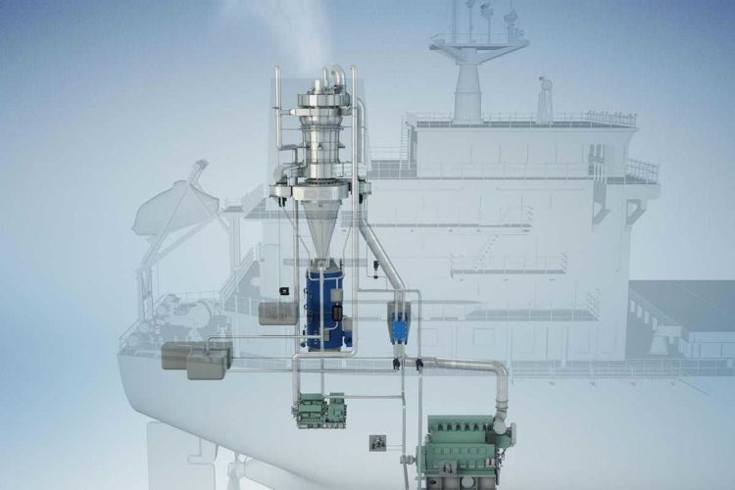
Examining different strategies for alarm prediction system for Alfa Laval’s Separator Machines
We investigate three types of tensor modelling:
Linear
Multi-linear
Non-linear

Slide 4
Objective
Alarm predictive model helps to overcome the problems of existing pre-defined thresholds alarm system.
The state of black box models versus white box tensor models

Slide 5
Research Questions
Which strategy provides better/interpretable predictions?
Which sets of configuration settings makes a better predictive model.
To determine the ideal window size for collecting samples prior to the occurrence of alarms and warnings.
To determine what sampling frequency in time series is best for making better predictions.
Best tuned models of different types together : fair comparison

Slide 6
Novelty
Industrial novelty: unfortunately, currently no predictive model is being used in the company! This is the first effort towards using machine learning in alarm prediction
Scientific novelty: Providing guidance towards choosing the right modeling strategy with regards to the company’s data characteristics. No previous investigation is made on trade-off between black-box tensor models and white-box tensor models on real-world data.

Slide 7
Methodology

Slide 8
Methodology
Data Collection
The flow diagram is splited into three parts i.e., Data PreProcess, Data Transformation and Model Prediction. In data preprocess, raw data is cleaned and normalized then dividing and selecting the samples for further data transformation. After data transformation in Linear and Multi-Linear, model prediction is done in vector, matrix, tensor and non- linear models.
Splitting Data
Data Cleaning
Dividing & Selecting window samples
Data Transformation
Predictive Model
Fig: Flow Diagram of proposed method

Slide 9
Data Set
27 water purifier machines installed on different ships. These machines purifies oil and water supplies onboard marine vessels.
Alarm: 30.
Alarms types : A10, A13, A17, A33, A69, A501 , A502 and etc.
Sensors: 102
Features : PT201_16, PT201_71, LPS1_voltage_value, QIT201 and etc.
Time stamp
Sampling: 3-12 months, depending on the machine

Slide 10
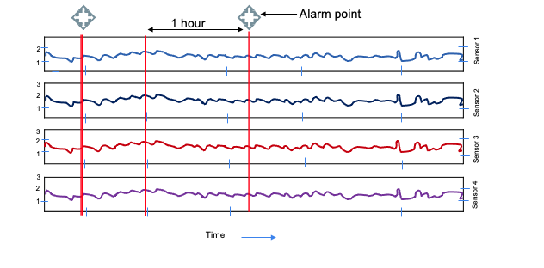
Data Preprocess
The original data was in time series of irregular pattern of different sensors,
made it equally interval by resampling it.
The data is selected from 5 seconds before the point when the alarms or warning happens until one hour before of it.
Ignored the alarms of less data samples.

Slide 11
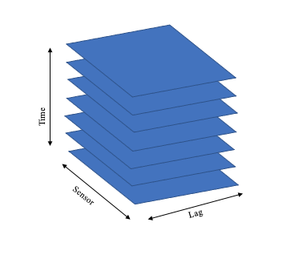
Sensor
Time
Representation of generated Tensor Data after preprocessing

Slide 12
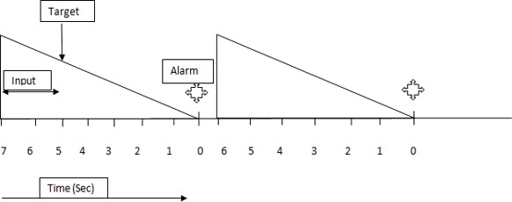
Dividing and Selecting window Samples
Fig: Remaining useful life
720 Instants x 5 sec
W1
Y
W1
Alarm
3450
TG= 5 Sec
720x5-30x5 = 3450
ws = 30
Examples 30
150 Seconds
The total window is an one hour i.e. 720 time instants x 5 seconds of sampling frequncy which is 720x5 = 3600 seconds

Slide 13
Alarm
720 Instants x 5 Sec
W2
W2
Y
3300
TG= 5 Sec
720x5-300 = 3300
ws = 30
Examples 30
150 Seconds
Figuare (s1)
Alarm
720 Instants x 5 Sec
W End
Y
W End
0
TG= 5 Sec
720x5-3600 = 0
ws = 30
Examples 30
150 Seconds
Figuare (s2)

Slide 14
Data Transformation
In data transformation, It transformed in three forms Vector, Matrix and Tensor methods.
The concept of Hankelization is introduced in Tensor and Matrix. In Tensor method, includes an additional dimensionality known as lag.
Vector
(Linear)
Hankelization
Hankelization
Lag
Matrix
(Multi-linear)
Tensor
(Multi-linear)

Slide 15
Model Prediction
Linear
Multi Linear
Non Linear
Linear Regression
Matrix Regression
Tensor Regression
Tensor
CNN
Tensor LSTM
Model prediction is done in linear regression (1-D Tensor), matrix regression (2D Tensor), tensor regression (3D Tensor) and non-linear models i.e., Tensor CNN (3d Tensor) and Tensor LSTM (3D Tensor) models and examine the performance with different experimental configuration.

Slide 16
Experimental Configuration
Machines used : 13, 14 & 15
Alarm Types : A33, A69, A502
Time Granularity : 5 sec, 7 sec, 10 sec, 13 sec, 15 sec, 20 sec.
Window Size : 1 min, 2 min, 3 min, 5 min, 10 min, 15 min, 20 min.
Lag Size : 1, 2, 3, 4, 5, 6, 7, 8, 10.

Slide 17
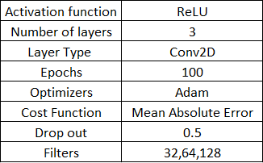
Convolutional Neural Network
The convolutional neural networks is the ability to automatically learn a large number of filters in parallel specific to a training dataset under the constraints of a specific predictive modelling.
In our experiment results, the below architecture convolutional model performed the best with the following parameter.

Slide 18
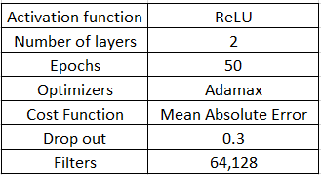
Long Short-Term Memory
LSTM is known and capable for learning order dependency in sequence prediction problems. We have used Multivariate LSTM model. In our experiment result, the below architecture LSTM model performed the best with the following parameter.

Slide 19

Results

Slide 20
Train Results for Alarm A33
Alarm A33 | Machine 13 |  | Machine 14
Methods | Configuration | Train MAE | Configuration | Train MAE
Tensor Regression | (TG:5,W:10,L:2,S1806) | 624.4 | (TG:20,W:5,L:8,S543) | 688.2
Tensor-Convolutional Neural Network | (TG:20,W:5,L:8,S903) | 816.9 | (TG:20,W:5,L:8,S903) | 867
Vector linear Regression | (TG:5,W:5,S3612) | 980.3 | (TG:5,W:5,S2172) | 926.5
Matrix Regression | (TG:5,W:10,S1806) | 721.4 | (TG:5,W:10,S1086) | 776.8
Tensor - lstm | (TG:10,W:1,L4,S9030) | 894.2 | (TG:15,W:10,L6,S362) | 903.1
Test Results for Alarm A33
Alarm A33 | Machine 13 |  | Machine 14
Methods | Configuration | Test MAE | Configuration | Test MAE
Tensor Regression | (TG:5,W:10,L:2,S1806) | 883.6 | (TG:20,W:5,L:8,S543) | 923.6
Tensor-Convolutional Neural Network | (TG:20,W:5,L:8,S903) | 843.2 | (TG:20,W:5,L:8,S903) | 835.3
Vector linear Regression | (TG:5,W:5,S3612) | 1104.8 | (TG:5,W:5,S2172) | 1193.8
Matrix Regression | (TG:5,W:10,S1806) | 1034.1 | (TG:5,W:10,S1086) | 1080
Tensor - lstm | (TG:10,W:1,L4,S9030) | 920.4 | (TG:15,W:10,L6,S362) | 965.7
Alarm A33 is present in Machine 13, 14 and 15. The train mean absolute error of tensor regression is optimal in all the machines with different configuration settings such as TG (Time granularity), window size and lag values.
Tensor convolutional neural network is robust to overfitting , as we can see there is a low variance in the train and test cases.

Slide 21
Train Results for Alarm A33
Alarm A33 | Machine 15
Methods | Configuration | Train MAE
Tensor Regression | (TG:20,W:5,L:8,S897) | 611.5
Tensor-Convolutional Neural Network | (TG:15,W:10,L:8,S598) | 662.3
Vector linear Regression | (TG:5,W:1,S17940) | 883.9
Matrix Regression | (TG:15,W:10,S598) | 664.3
Tensor - lstm | (TG:15,W:2,L6,S1810) | 949.8
Test Results for Alarm A33
Alarm A33 | Machine 15
Methods | Configuration | Test MAE
Tensor Regression | (TG:20,W:5,L:8,S897) | 1058.1
Tensor-Convolutional Neural Network | (TG:15,W:10,L:8,S598) | 775.6
Vector linear Regression | (TG:5,W:1,S17940) | 1208
Matrix Regression | (TG:15,W:10,S598) | 1124.3
Tensor - lstm | (TG:15,W:2,L6,S1810) | 954.3
Out of these three machines, Alarm A33 has a better performance in machine 15 with configuration settings (TG:20,W:5.L:8,S:897).However the variance is high in
Tensor regression for all machines due to the non-linearity of the data.

Slide 22
Train Results for Alarm A502
Alarm A502 | Machine 13 |  | Machine 15
Methods | Configuration | Train MAE | Configuration | Train MAE
Tensor Regression | (TG:5,W:2,L:2,S330) | 580.8 | (TG:5,W:2,L:2,S360) | 480.4
Tensor-Convolutional Neural Network | (TG:10,W:1,L:2,S660) | 824.2 | (TG:5,W:1,L:2,S720) | 827.2
Vector linear Regression | (TG:5,W:3,S220) | 974.9 | (TG:5,W:2,S360) | 774.6
Matrix Regression | (TG:5,W:2,S330) | 584.5 | (TG:15,W:1,S240) | 589.1
Tensor - lstm | (TG:10,W:1,L4,S330) | 834.8 | (TG:5,W:1,L2,S720) | 969.4
Test Results for Alarm A502
Alarm A502 | Machine 13 |  | Machine 15
Methods | Configuration | Test MAE | Configuration | Test MAE
Tensor Regression | (TG:5,W:2,L:2,S330) | 1013.5 | (TG:5,W:2,L:2,S360) | 991.6
Tensor-Convolutional Neural Network | (TG:10,W:1,L:2,S660) | 935.3 | (TG:5,W:1,L:2,S720) | 980.9
Vector linear Regression | (TG:5,W:3,S220) | 1190.1 | (TG:5,W:2,S360) | 1150.1
Matrix Regression | (TG:5,W:2,S330) | 1137.2 | (TG:15,W:1,S240) | 1177.3
Tensor - lstm | (TG:10,W:1,L4,S330) | 972.8 | (TG:5,W:1,L2,S720) | 1252
Alarm A502 is present in Machine 13 and 15. It is observed that Tensor regression outperforms other methods, and has a better performance in machine 15 with a configuration settings (TG:5, W:2, L:2, S 360)

Slide 23
Train Results for Alarm A69
Alarm A69 | Machine 13 |  | Machine 14
Methods | Configuration | Train MAE | Configuration | Train MAE
Tensor Regression | (TG:5,W:10,L:2,S1812) | 633.9 | (TG:20,W:5,L:8,S546) | 602.8
Tensor-Convolutional Neural Network | (TG:20,W:5,L:8,S906) | 808.9 | (TG:10,W:10,L:4,S546) | 794.6
Vector linear Regression | (TG:20,W:5,S906) | 880.3 | (TG:15,W:1,S3640) | 1057.6
Matrix Regression | (TG:15,W:5,S1208) | 864.4 | (TG:15,W:5,S1208) | 774.2
Tensor - lstm | (TG:15,W:2,L6,S330) | 834.8 | (TG:5,W:2,L2,S5460) | 885.4
Alarm A69 | Machine 13 |  | Machine 14
Methods | Configuration | Test MAE | Configuration | Test MAE
Tensor Regression | (TG:5,W:10,L:2,S1812) | 1080.8 | (TG:20,W:5,L:8,S546) | 880.8
Tensor-Convolutional Neural Network | (TG:20,W:5,L:8,S906) | 831.1 | (TG:10,W:10,L:4,S546) | 829.1
Vector linear Regression | (TG:20,W:5,S906) | 1242.3 | (TG:15,W:1,S3640) | 1276.2
Matrix Regression | (TG:15,W:5,S1208) | 1124.6 | (TG:15,W:5,S1208) | 919
Tensor - lstm | (TG:15,W:2,L6,S330) | 972.8 | (TG:5,W:2,L2,S5460) | 923.4
Test Results for Alarm A69
Alarm A69 is present in Machine 13 and 14. The train performance in both the machines are almost similar, but the machine 14 has a clear edge over machine 13.
The settings of (TG:20,W:5,L:8,S:546) is the best optimal settings for Alarm A69.

Slide 24

Conclusion & Plan ahead

Slide 25
Conclusion
The proposed Tensor representation method performance on multi-sensor unequal-length time series machine dataset is better compared to Vector and Matrix models.
Multi-linear methods outperforms linear method
Comparing multilinear and nonlinear method shows that multilinear modelling suffers from overfitting problem.
Tensor convolutional neural network is robust to overfitting however, train error is higher than Tensor Regression.
Tensor LSTM vs. Tensor CNN vs. Tensor Regression

Slide 26
Plan Ahead
To reduce the variance of Tensor regression.
Final Report Preparation.
Final Presentation and submission.

Slide 27
Thank you!!
&
Questions

